Slide 1
Social Media Analytics
Topic 10: Align Social Media with core business goals and social media goals

Slide 2
Learning Objectives
Gaps between executives and marketers
Setting social media goals
Three primary marketing goals
Align goals with sales funnel

Slide 3
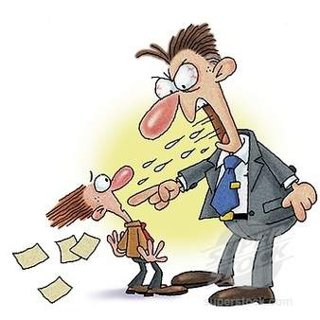
Gaps between priorities of executives and marketers
A 2011 study of C-level executives and vice presidents shows that only 27% listed social business as a top strategic priority
47% admitted a social plan was necessary and 19% said social business strategy not necessary
90% of marketers stated social media is important to their business
2011 Jive Social Business Index Survey

Slide 4
Gaps between priorities of executives and marketers
Why is there such as gap?
Combination of differing priorities
Differing perspectives on what drive business
Differing measurement of success
Marketers
Growing followings and fans base
Increasing engagement on social networking
Executives
Return On Investment (ROI)

Slide 5
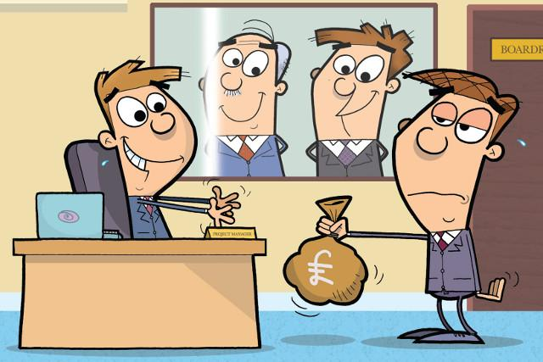
Can we measure social media ROI?
TOUGH QUESTIONS !!!
Not readily available
Many social media vendors claim to measure ROI, but it does not provide all the insights the management wants
Aligning social media strategies to business goals

Slide 6
Setting Social Media Goals
Social Media helps to achieve three common marketing goals
Lead Generation
Customer Retention
Brand Awareness
Social Media

Slide 7
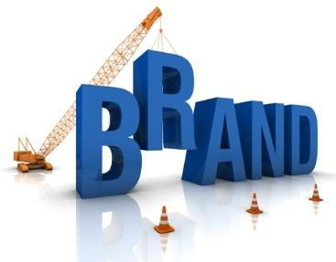
Three Primary Marketing Goals
Brand awareness
Aimed at generating leads, and retaining your existing customers
Aimed at generating more exposure and getting more eyeballs on your brand
The goal is to have more people who recognize your brand and know your company’s name

Slide 8
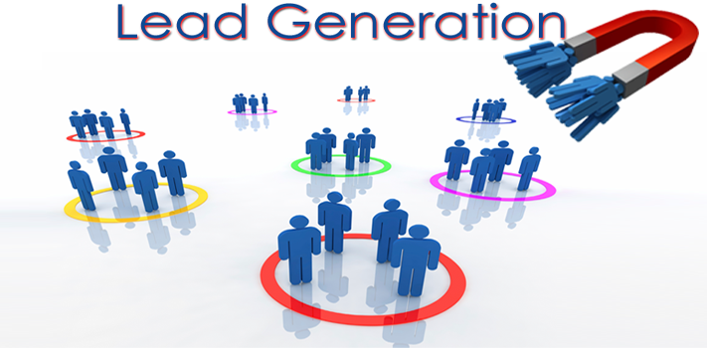
Three Primary Marketing Goals
Lead Generation
Finding more sales and revenue opportunities for your company
Using marketing to sell more products or services

Slide 9
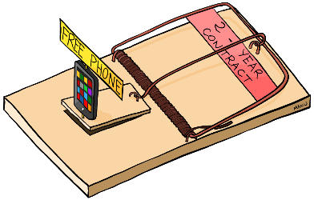
Three Primary Marketing Goals
Customer retention
Keeping your existing customers coming back for more

Slide 10
Social media goal 1: Increase brand awareness
Social media enables you to reach more people at a significantly lower cost
Develop relationships and provide value to your target audience, which will help you remain top of mind when the audience makes a buying decision

Slide 11
Goal 1 : Case study - King Arthur Flour generates brand awareness and loyalty with social media
Flour?
It’s impossible to get people to care about flour right?
WRONG !!

Slide 12
Goal 1 : Case study - King Arthur Flour generates brand awareness and loyalty with social media
Interesting approach
Rather than focusing on the benefits of using its flour
It focus on end products
Use social media
A corporate blog where it shares recipes for delicious food
A Twitter account where it talks to cooks and bakers about the great food they create
A Facebook account to share fantastic photos

Slide 13
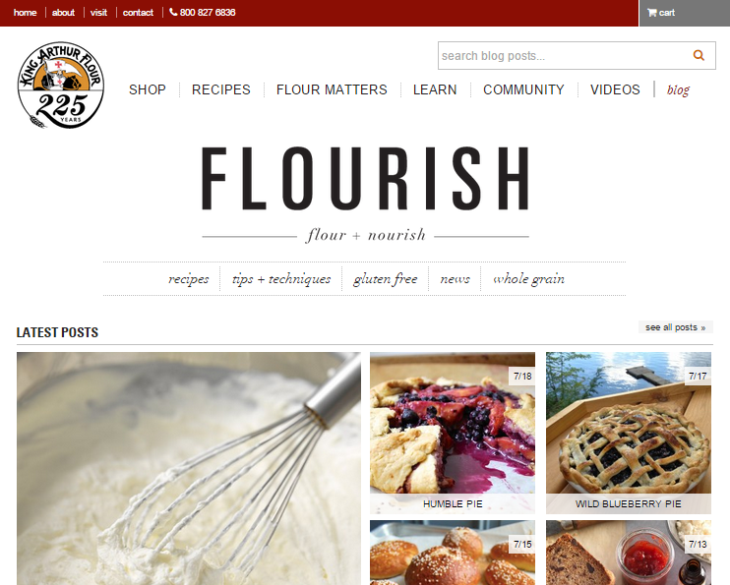
Goal 1 : Case study - King Arthur Flour generates brand awareness and loyalty with social media
Result
63,000 Facebook fans and more than 13,000 followers on Twitter

Slide 14
Social media goal 2: Generate more leads
Do not use social media as a board cast platform for your promotions
Should be an engagement
An effective lead-generation strategy is making it super easy to buy when the client is ready to buy

Slide 15
Goal 2 : Case study – Under Armour makes it super easy to buy
On Facebook
Provides tips for athletes, takes polls on what athletes find important, shares interviews with celebrity users
Engage in conversations and encourage fans and followers to share opinions
Asks pointed questions about what fans considers when making a purchase decision for products it carries
Make the products easy to purchase

Slide 16
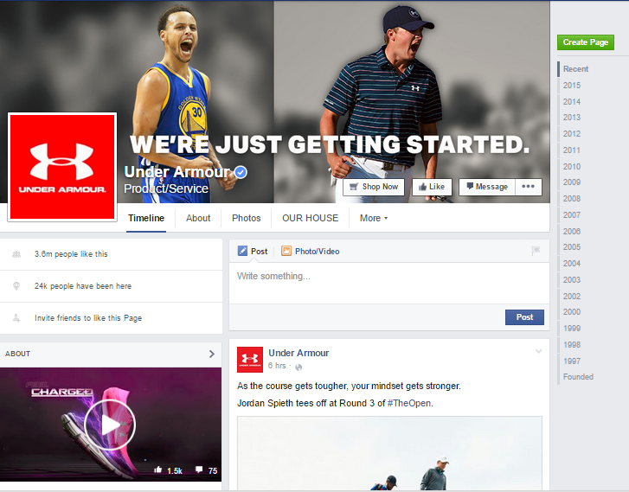
Goal 2 : Case study – Under Armour makes it super easy to buy
Provide a “Shop Now” button that link directly with their website
Click on product images and immediately make a purchase

Slide 17
Social media goal 3: Retaining your existing customers
Provides better customer services
Increase revenues through customer’s repeat business
Social media acts as a two-way communication with existing customer base
Answer questions
Respond to feedback
Share client success stories
Help marketers understand the voice of the customers

Slide 18
Goal 3 : Case study – Boingo Wireless manages customer service on Facebook and Twitter
On Facebook
Help customers get online through its Wi-Fi network almost everywhere in the world
If customers complain, Boingo is right there to help them get online quickly and efficiently

Slide 19
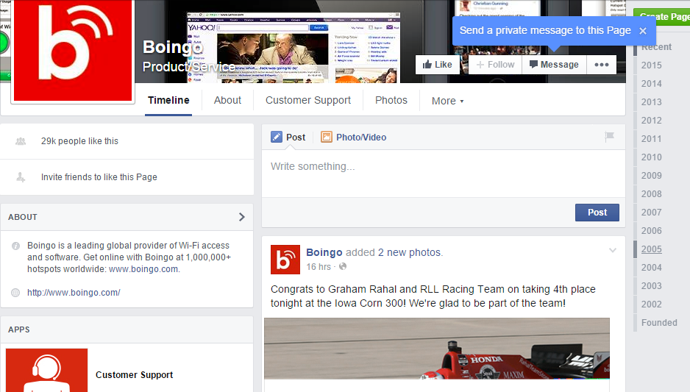
Goal 3 : Case study – Boingo Wireless manages customer service on Facebook and Twitter

Slide 20
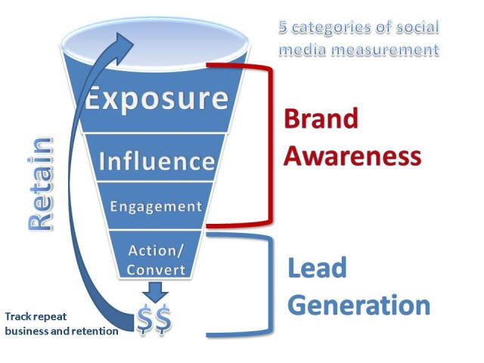
Align goals with Sales funnel
The best way to show how social media contributes to the bottom line

Slide 21
Where Brand Awareness fits?
The first three categories of the new sales funnel align with the goals for brand awareness
Exposure is a measure of brand reach
Influence is a measure of how many influencers helped to spread the message
Engagement is a measure of how many people interact with your brand

Slide 22
Where Action/Conversion fits?
Solely dedicated to qualified leads and those who go on to purchase your products or services
Social media leads tend to be earlier in the buying cycle
Engage the users to provide information, do a good job of following up with the appropriate content to your potential customers

Slide 23
Where Customer Retention fits?
Last stage of the sales funnel
Look at the retention rate for customers
A measurement of how long they stay customers
Especially important for companies that charge a monthly or annual fee

Slide 24
Align actual activities in social media channels with the sales funnel
Notices a retweet of a resource your company shared and took no action
See a post Jason Falls wrote with a review of your products
Starts following your Twitter account and looks at some of your latest tweets. Sees a really great whitepaper, which he retweets to his audience. Goes to your website

Slide 25
Align actual activities in social media channels with the sales funnel
Fill out a form to download the whitepaper
See that you have a webinar on Friday to explain your products. Decides to register.
Love the webinar and what you have to offer. Decides to set up a meeting with the sales team. Fill out form on site to request times
Has a meeting with your sales representatives and decides the company need your product. Make a purchase

Slide 26
Align actual activities in social media channels with the sales funnel
Love your product. Follows your social channels to keep up-to-date with the company. Sees a tweet for a free trial of an add-on product he’s been considering. Click on the link and goes to your site.
Fill out the form for a free trial.
Love the add-on and adds it to his account.

